Slide 1
If you are building or renovating then taking action on what you learn on this short training video will be one of the most valuable thing you can do

Slide 2
Why?

Slide 3
How to avoid
#1 most costly mistake people make when doing a building project.

Slide 4
Problem =
NOT completing the project
‘On time and on budget’

Slide 5
Cause = lack of upfront planning

Slide 6
‘If only I’d known’

Slide 7
Five steps to a successful project
Needs and Options
Concept design
Building documentation
Bidding and negotiation
Construction phase

Slide 8
Needs and Options
GOOD = make changes effortlessly

Slide 9
Needs and Options
BAD = pay big costs to correct OR settle for lesser design

Slide 10
Approximate cost to make changes
Needs and Options
Concept design
Building documentation
Bidding and negotiation
Construction phase
$1
$3
$15
$15
$50

Slide 11
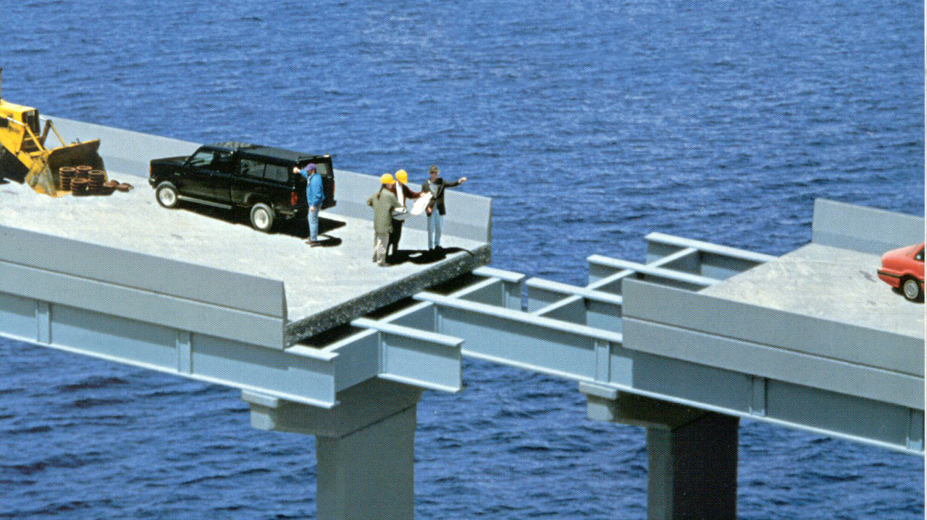

Slide 12
Opportunity To Make Changes
High
Low
Time

Slide 13
Cost To Make Changes
High
Low
Time

Slide 15
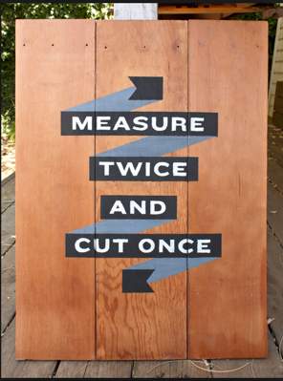

Slide 16
Establish Needs and Options Early
Opportunity for change
Cost of change
High
Make design
changes here
Not here
Low
Time

Slide 17
When is the best time to make changes to a project?
Needs and Options Review
Concept design
Building documentation
Bidding and negotiation
Construction phase
$1
$3
$15
$15
$50

Slide 18
Needs and Options Review™
Do you need one?

Slide 19
How clear are you on exactly what you need?
5
Not at all
0
Completely
10

Slide 20
How clear are you on all the options your site will accommodate?
5
Not at all
0
Completely
10

Slide 21
How confident are you that you are aware of all the legal requirements?
5
Not at all
0
Completely
10

Slide 22
How aware are you of the process you will need to have in place to get your project completed on time and on budget?
5
Not at all
0
Completely
10

Slide 23
Needs and Options Review™
How confident are you that your budget will achieve your needs?
5
Not at all
0
Completely
10

Slide 24
Don’t worry about not being able to answer all these questions at 10/10 yet.
Because the Needs and Options Review™ will allow us to fill in the gaps (reduce your need for late changes).

Slide 25
Every project needs to build on solid foundations

Slide 26
We only work with clients who are prepared to complete this step properly with us.
We will not rush this step.

Slide 27
The Needs and Options Review™ is the most important step because it lays the foundation for a successful project.

Slide 28
The valuable insights you gain from this first phase can be used by us or any other architect and will ultimately produce a better result for you.

Slide 29
Q
Can I skip this step?

Slide 30
A
Not doing a thorough
Needs and Options Review™
could be the most expensive
decision you ever make

Slide 31
Complete your project on time and on budget by completing the
Needs and Options Review™
booking form below

